Slide 1
Alignment evaluation

Slide 2
2550 DEGs
421 DEGs
2016 DEGs
258 DEGs

Slide 3
83 DEGs
40 DEGs
661 DEGs
484 DEGs

Slide 4
102 DEGs
220 DEGs
63 DEGs
125 DEGs

Slide 5
K70_vs_K70MD_pvalue01_fc4 - DEGs (2016)

Slide 6
K70_vs_P10_pvalue05_fc4 - DEGs (421)
Notes:
P10_3 could be an outlier!!

Slide 7
K70_vs_NKO70_pvalue05_fc2 - DEGs (661)
Notes:
NKO have most down-regulated genes
P70_1_2: have up-regulated genes, P70_3 are more like MD

Slide 8
DDIT4,GJB4, IL21R ,MAP3K7CL, MOBP, ODAPH ,RAET1L, RFX8, SPINK2, SPINK6, SYTL2, ZBED2
LINC01204, LINC02321
LOC101929128, LOC102546229, LOC105379051

Slide 9
DEGs were selected at
adjusted p-value < 0.01
and FC > 2

Slide 10
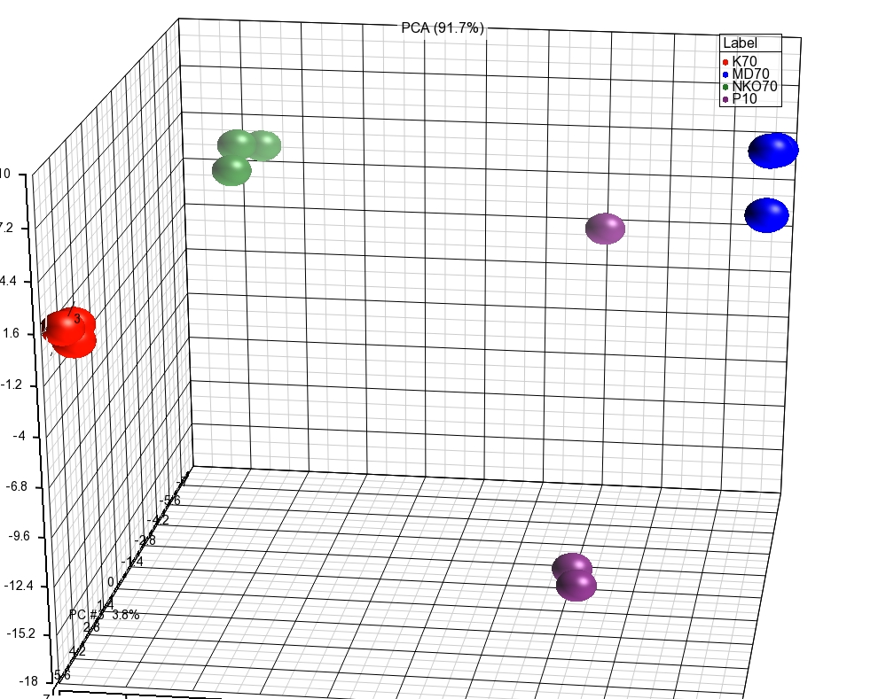
Common DEGs (K70MD & K70P10) – 593 genes

Slide 11
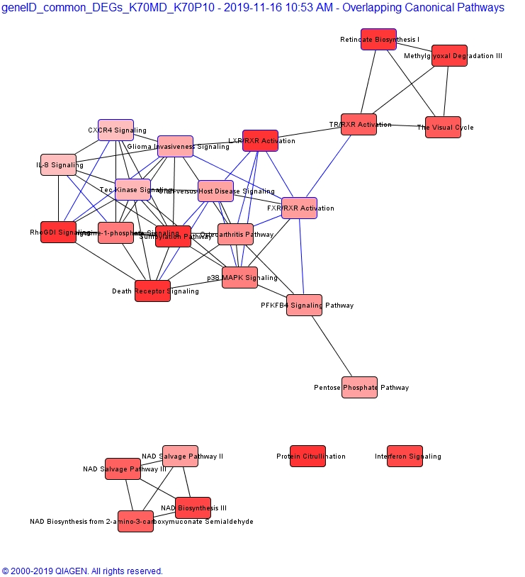

Slide 12
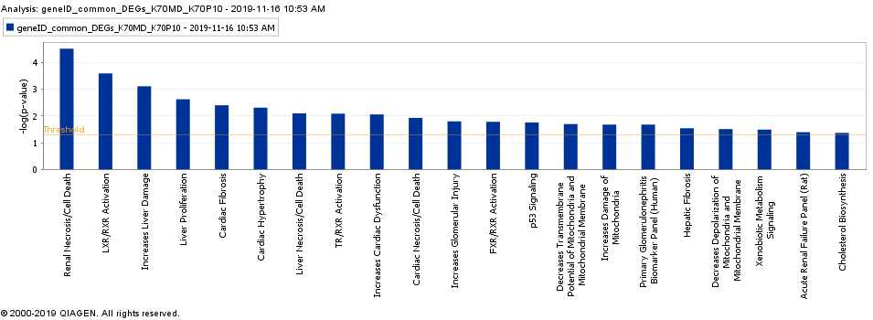

Slide 13
DEGs were selected at
adjusted p-value < 0.01
and FC > 2
DEGs were selected at
adjusted p-value < 0.01
and FC > 4

Slide 14
DEGs for K70MD were selected at
adjusted p-value < 0.01, and FC > 4
DEGs for P10 were selected at
adjusted p-value < 0.01, and FC > 2
DEGs were selected at
adjusted p-value < 0.01
and FC > 4
Notes:
None of 196 overlap with PAM50!!

Slide 15
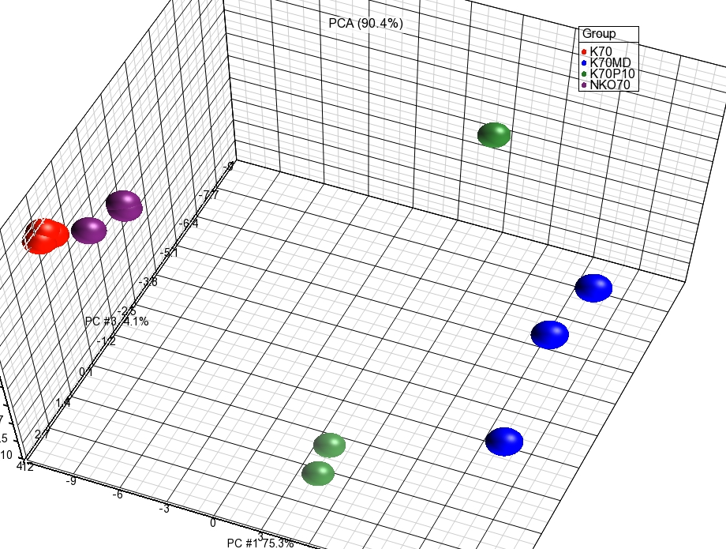
ESCC_196_signatures

Slide 16
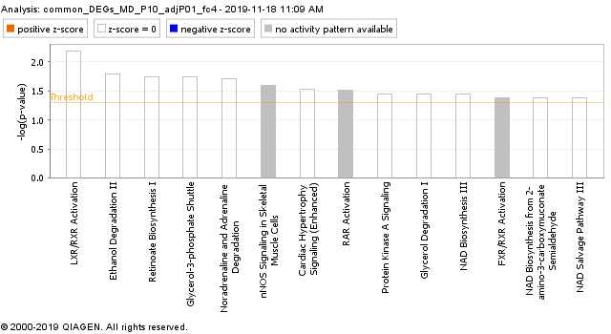
ESCC_196_signatures

Slide 17
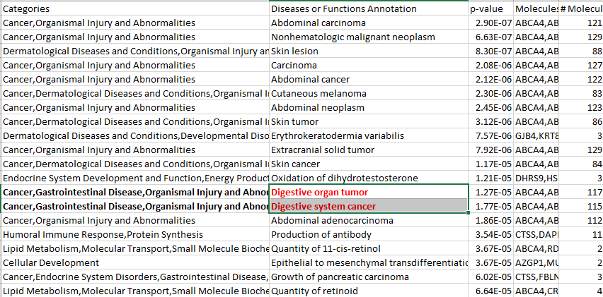
IPA – disease related results (ESCC_196_signatures)

Slide 18
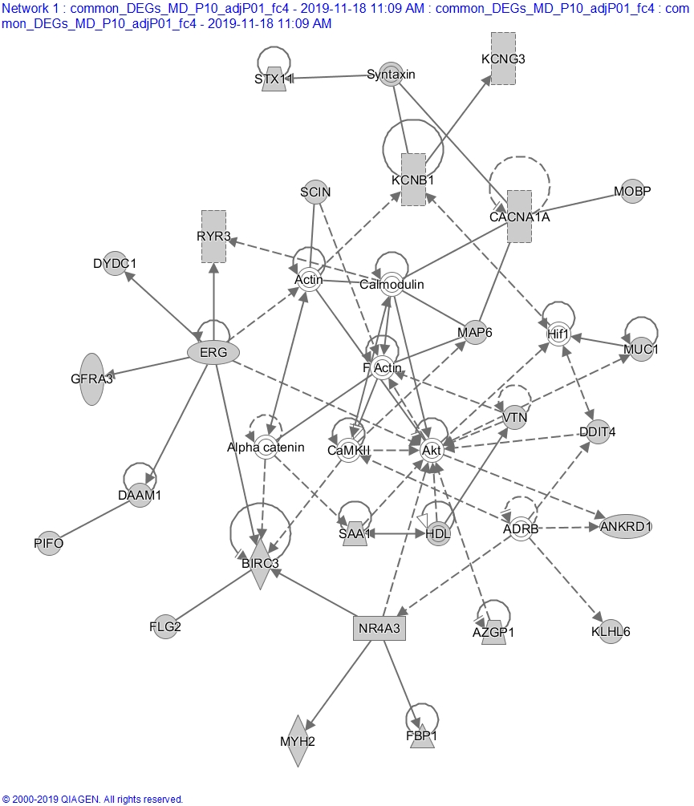

Slide 19
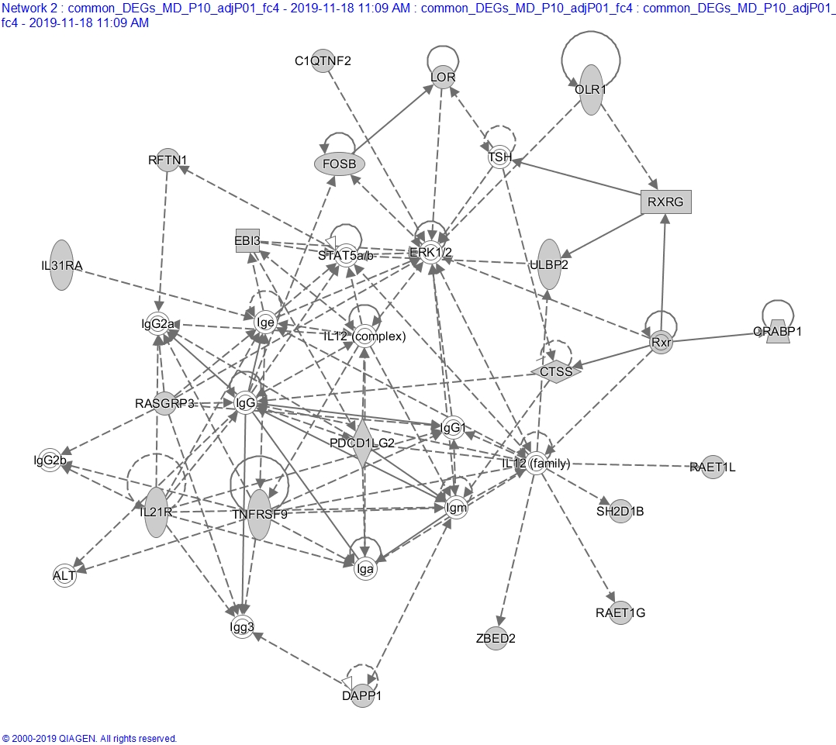

Slide 20
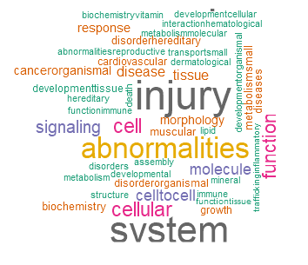
ESCC_196 signature -- disease cloud
https://2waybene.shinyapps.io/miRNATag/

Slide 21
Supporting slides

